Slide 1
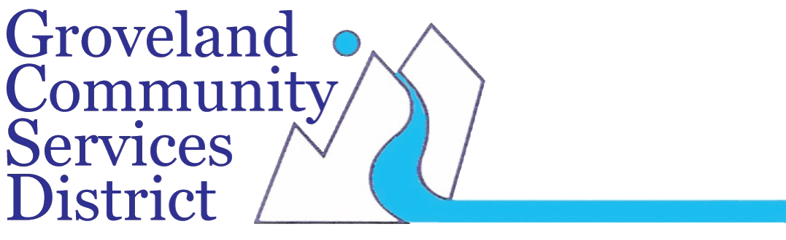
Tuolumne –Stanislaus Integrated Regional Water Management Project Update

Slide 2

Cyber Security Project
Cybersecurity Risks in Water and Wastewater Infrastructure
Weak and outdated communication systems
Vulnerability to cyber attacks
Previous incidents causing water supply disruptions and environmental contamination
Potential consequences: raw sewage overflow, chemical dosing compromise, inadequate treatment

Slide 3
Benefits of Cybersecurity Project
Strengthened network security and reliability
Enhanced protection against cyber threats
Improvement in energy efficiency and reduction of greenhouse gas emissions
Advantages of new communication systems and PLCs for optimized operations
Project Cost: $2,800,00

Slide 4
Advanced Metering Infrastructure Project
Project Objective:
Replace approximately 3,300 existing manual-reading water meters with an Advanced Metering Infrastructure (AMI) system.
Utilize cellular connectivity to improve accuracy and efficiency in water metering.
Environmental Impact:
Reduce greenhouse gas emissions and eliminate vehicle runs associated with manual meter readings.
Improve water conservation and reduce water loss within the public water system.

Slide 5
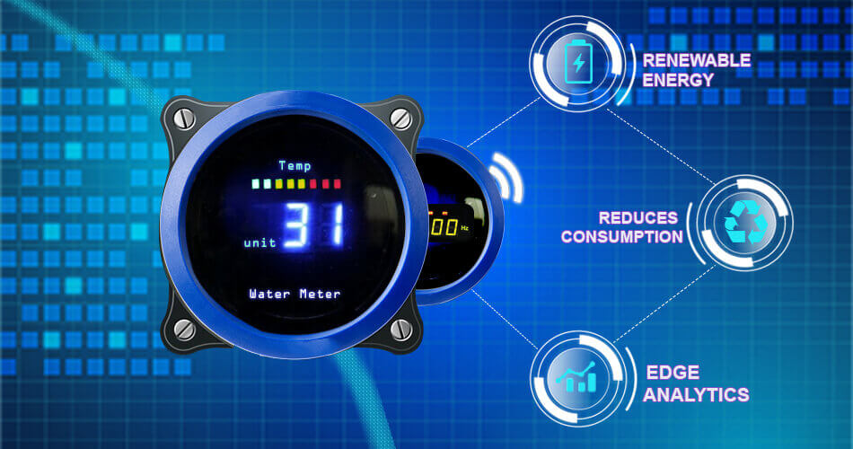
Benefits:
Enhance user satisfaction by providing accurate real-time data on water usage, conservation, and meter readings.
Enable water budgets, text notifications, and automatic shut-off valves to address plumbing issues or abnormal usage.
Water Savings:
Anticipated annual water savings of 20-acre feet through accurate measurement and volumetric pricing.
Additional customer conservation of approximately 68.5 acre-feet through new meter software and water budgeting features.
Emergency Response:
AMI system provides immediate detection and response to water system issues, leaks, and abnormal usage, especially during drought or emergency situations.
Enables quick identification and repair of underground water main leaks, preventing water loss and damage.
Environmental Contribution:
Implementation of AMI system contributes to long-term water conservation and short-term drought response strategies.
Improves water usage monitoring, conservation practices, and allocation of water resources, benefiting ecosystems like Hetch Hetchy Lake.
Project Cost $4,300,000

Slide 6
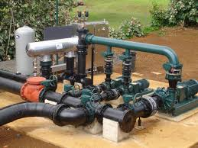
Irrigation Pump Station Improvements
Challenges Faced by Existing Irrigation Pump Station:
Underground location prone to flooding
Pump failures due to stagnant water
Potential flooding within the station
Risks to surrounding environment and infrastructure

Slide 7
Benefits of Irrigation Pump Station Improvements:
Valve Replacement for improved water flow control
Above-Ground Installation to mitigate flooding risks
Enclosure Installation for equipment protection
Flow Meter Vault Box for accurate monitoring
Second Pump Installation for dual-flow operation
Water conservation, regulatory compliance, ecosystem protection
Project Cost: $900,000

Slide 8
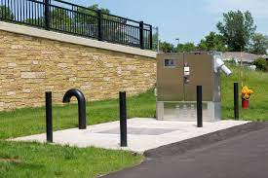
Lift Station Improvements Project
Project Objective:
Address critical challenges associated with excessive inflow and infiltration (I&I) in the existing lift station of the Groveland Community Services District (GCSD).
Enhance performance, reliability, and safety of lift station infrastructure within the collection system.
Challenges:
Risks of deteriorating physical and operational conditions leading to inadequate pumping capacity.
Potential for sanitary sewer overflows (SSOs), contamination of water resources, and environmental damage due to ineffective pumping of raw wastewater.
Key Improvements:
Wet Well Epoxy Coating
Pump Replacement
Bypass Arrangements
Safety Hazard Mitigation

Slide 9
Project Impact and Benefits:
Operational Efficiency:
Improved performance and reliability of lift station infrastructure.
Reduced risk of system overloads, pump failures, and potential flooding.
Environmental Protection:
Mitigation of sanitary sewer overflows (SSOs) and contamination of water resources.
Preservation of the surrounding environment and ecosystems.
Safety Enhancement:
Minimization of safety hazards within lift stations for maintenance personnel.
Creation of a safer working environment through enhanced safety measures.
Long-term Sustainability:
Prolonged lifespan of infrastructure through protective measures like epoxy coatings.
Enhanced resilience of the collection system against future challenges.
Project Cost $1,500,000

Slide 10
Groveland & Big Oak Flat Water Distribution System Improvement Project
Project Objective:
Address critical needs within the Groveland Community Services District (GCSD) water distribution system.
Current Challenges:
Aging infrastructure established in the 1960s, primarily consisting of AC pipelines nearing the end of their intended lifespan.
Regular burst pipelines disrupting service and contributing to excessive greenhouse gas emissions.
Proposed Solutions:
Transition to AWWA standard materials to improve reliability and efficiency.
Upsize water distribution mains to accommodate growing domestic water demands.
Install new gate valves, pressure reducing valves, and fire hydrants to enhance system functionality and safety.

Slide 11
System Upgrades and Community Impact
Meeting Growing Demands:
Upsizing water distribution mains to ensure adequate access to potable water within the service area.
Addressing domestic water demands while complying with fire flow requirements.
Enhanced Fire Protection:
Implementing system upgrades to meet fire flow requirements in an Extremely High Fire Hazard Zone.
Better equipped to protect the surrounding environment from devastating fires.
Water Conservation Efforts:
Reducing water loss through improved infrastructure and optimized distribution.
Benefiting communities served by GCSD and preserving aquatic life in the Hetch Hetchy reservoir and Pine Mountain Lake.

Slide 12
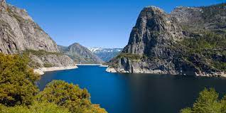
Environmental Conservation and Sustainability
Reducing Environmental Impact:
Minimizing greenhouse gas emissions associated with frequent pipeline replacements.
Conserving water resources and minimizing environmental impact through optimized distribution.
Preservation of Ecosystems:
Protecting aquatic life within the Hetch Hetchy reservoir and Pine Mountain Lake by reducing water drawn from each lake per year.
Contributing to the overall health and resilience of the surrounding ecosystem.
Long-term Sustainability:
Ensuring the long-term sustainability and reliability of the water distribution system for future generations.
Aligning with efforts to mitigate climate change and preserve natural resources.
Groveland Water System Cost $3,750,000
Big Oak Flat Water System Cost $2,500,000

Slide 13
Thank you
Peter Kampa
209-962-7161
pkampa@gcsd.org
www.gcsd.org

